Slide 1
C++ 14 Features
Function return type deduction
Alternate type deduction on declaration
Relaxed constexpr restrictions
Aggregate member initialization
Binary literals
The attribute [[deprecated]]
Digit separators
Variable Templates
Generic lambdas
Lambda capture expressions
Aggregate classes with default non-static member initializers
C++ 14 Libraries
std::make_unique
std:integer_sequence
std::quoted
std::exchange
user_defined literal for standard library types
std::shared_timed_mutex and std::shared_lock

Slide 2
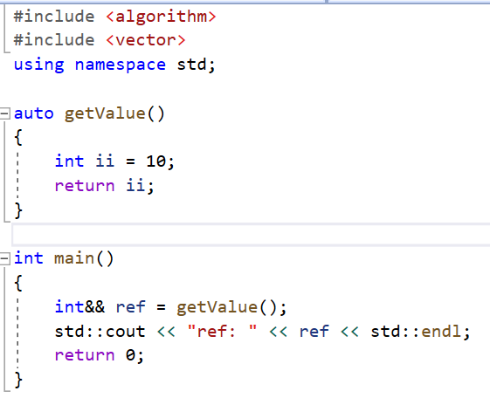
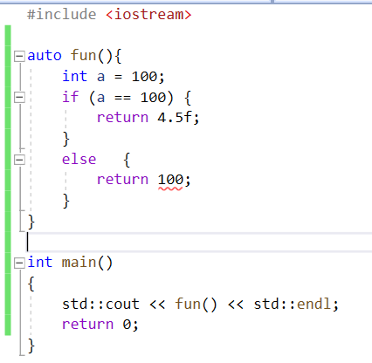
Function return type deduction
C++11 allowed lambda functions to deduce the return type based on the type of the expression given to the return statement.
C++14 provides this ability to all functions
In order to use auto type for function – the declaration must use ‘auto’ keyword as a return type on function declaration
If multiple return expressions are used in the function's implementation, then they must all deduce to same type.
All return deduce to same type
Error: C3487-'int': all return expressions must deduce to the same type: previously it was 'float' List

Slide 3
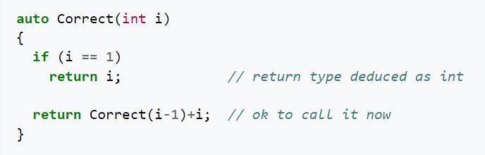
Function return type deduction continued …
Functions that deduce their return types can be forward declared, but they cannot be used until they have been defined
Even recursive calls also can use this feature

Slide 4
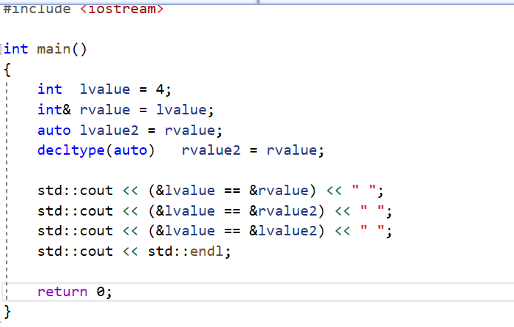
Alternate type deduction on decltype
C++14 added the combined decltype(auto) in order to be able to deduce a reference type

Slide 5
Relaxed constexpr restrictions
Main advantage
Lot of restrictions removed on constexpr functions & modified rules for C++14 on constexpr as follows:
C++11
C++14
Constexpr must contain single return statement
Constexpr function should refer only to constant global variables
Constexpr function can call only other constexpr functions not simple functions
Constexpr should not be void type
Pre-increment not allowed in constexpr function
Allow declarations within constexpr functions, other than:
  static or thread_local variables
  Un-initalized variables
  Allow if and switch statements (but not goto)
  Allow all looping statements: for(Including range based for), while and do-while
  Allow mutation of objects whose lifetime began within the constant expression evaulation

Slide 6
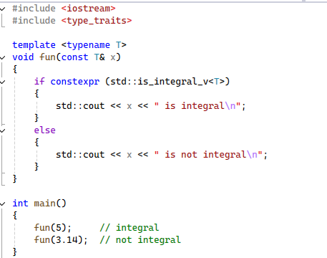
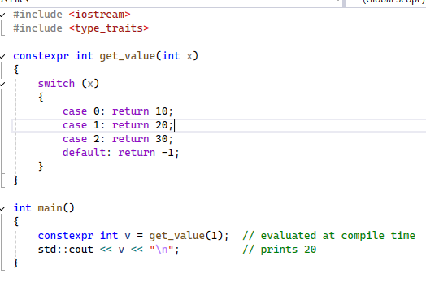
Relaxed constexpr continuation …
if-switch case can be evaluated during compile time using constexpr
Cpp14/constexpr_if_example1.cpp at main · shidlingayya/Cpp14
Cpp14/constexpr_switch_example.cpp at main · shidlingayya/Cpp14

Slide 7
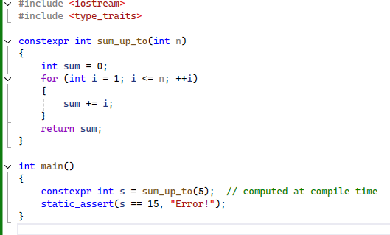
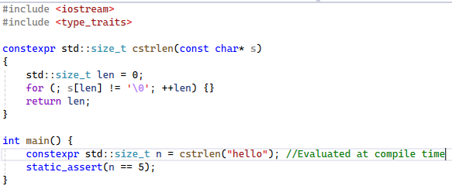
Relaxed constexpr continuation …
Consider below example for loop which evaluate during compile time
Cpp14/conexpr_loop_example.cpp at main · shidlingayya/Cpp14
Cpp14/conexpr_loop_example1.cpp at main · shidlingayya/Cpp14

Slide 8
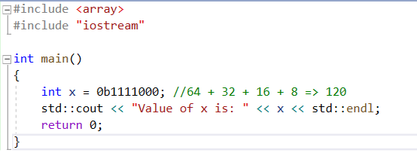
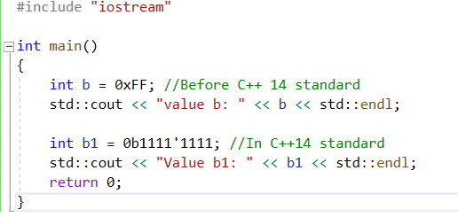
Binary literals
The previous version of before C++14.. Usage of direct binary numbers not allowed in code
We need to convert them from basic types like decimal, hex or octal to perform required operations
In C++14 – Binary literals allowed directly
The binary literals starts with 0b or 0B
This syntax is borrowed from other languages such as D, Java, Perl, and Python, all of which support binary literals
Cpp14/BinaryLiternal_DigitSeparator.cpp at main · shidlingayya/Cpp14
We can use ‘ separator to separate the binary byte, nibble or words

Slide 9
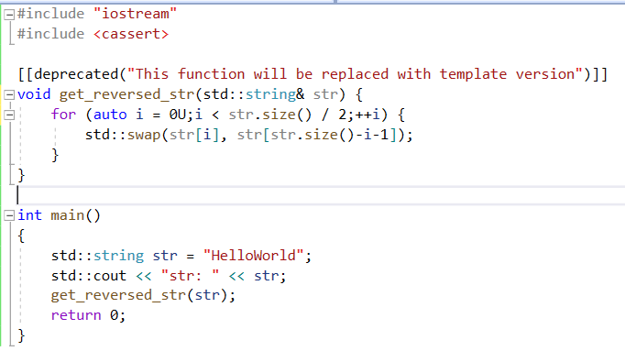
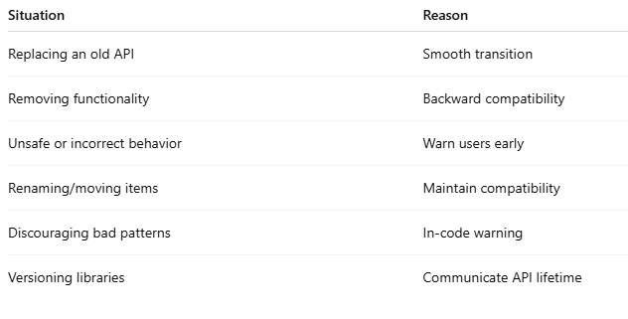
The attribute [[deprecated]]
It means – The use of name or entity declared with this attribute is allowed, but discouraged for some reason
Compiler gives error and if any string literals (reason for deprecation) are provided it will be included in error
This feature can be used for – class, struct, union, typedef, variable, non-static data member function, function, namespace, enumeration, enumerator and template specialization
Syntax:
[[deprecated]] – Without reason
[[deprecated(“reason”)]] – With reason
Cpp14/deprecated_attribute.cpp at main · shidlingayya/Cpp14

Slide 10
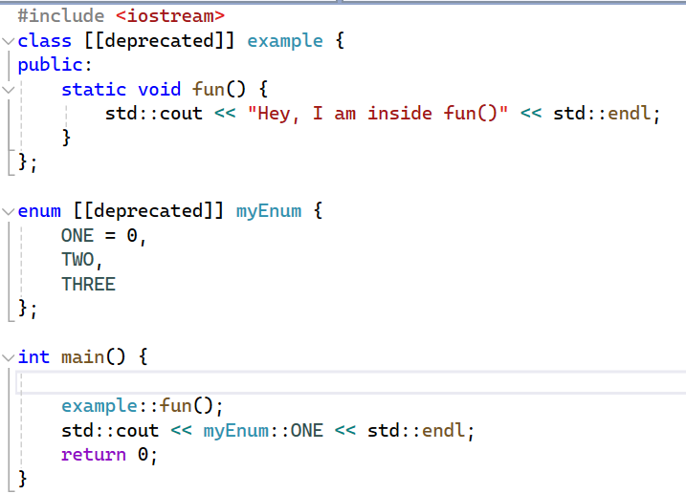
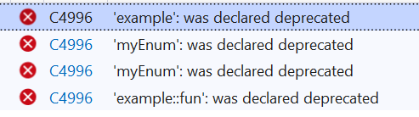
The attribute [[deprecated]] continued …
The class and enum can be made deprecated as follows

Slide 11
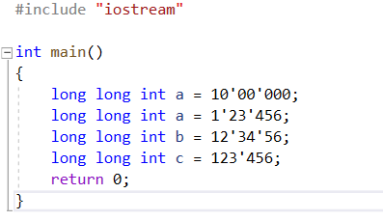
Digit Separators
In c++14 – the digit separators are introduced
This feature helps to improve the readability of big numbers which are difficult to read
Ex: 1000000
C++14 has introduced a feature, and its name is Digit Separator and denoted by a simple quotation mark (‘)
This digit separator is for only users
The compiler automatically reads whole number when used by ignoring digit separator

Slide 12
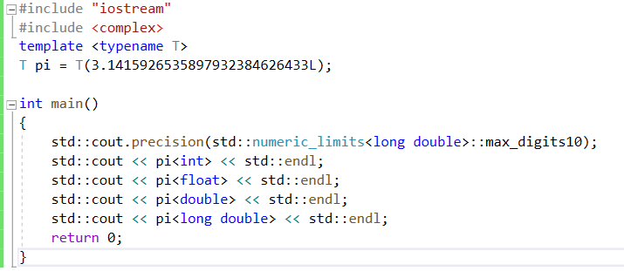
Feature: variable template
Before C++14, we had class template and function template
The C++14 introduced – variable template
The global or class variables can be template variables
Cpp14/variable_template.cpp at main · shidlingayya/Cpp14

Slide 13
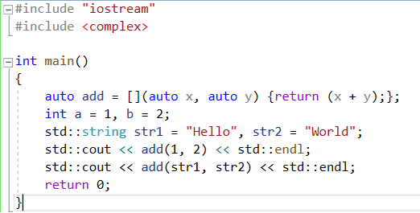
Generic lambdas
Before C++14, The lambda expressions type specific
The C++14 introduced – Generic lambdas – Same lambda can be used across multiple data types
It works same as normal function template

Slide 14
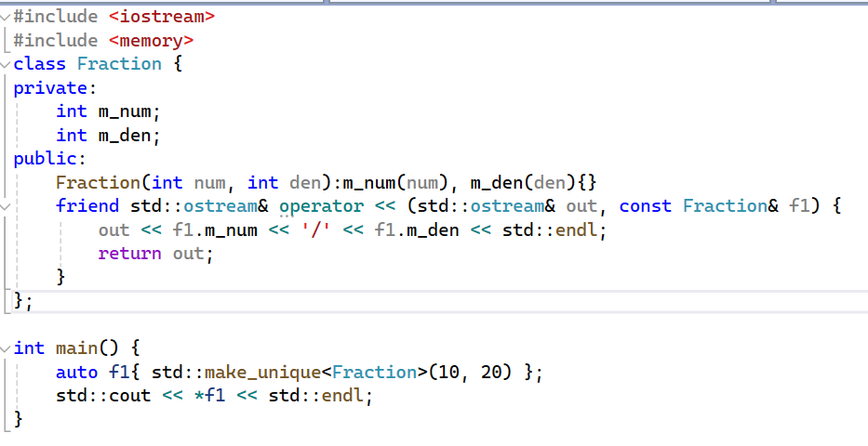
std::make_unique
This make_unique used to assign memory to std::unique_ptr
It is good programming to use std::make_unique instead of direct use of new operator because C++14 with make_unique resolves exception safety issue
Also, using make_unique enables programmer to write less code

Slide 15
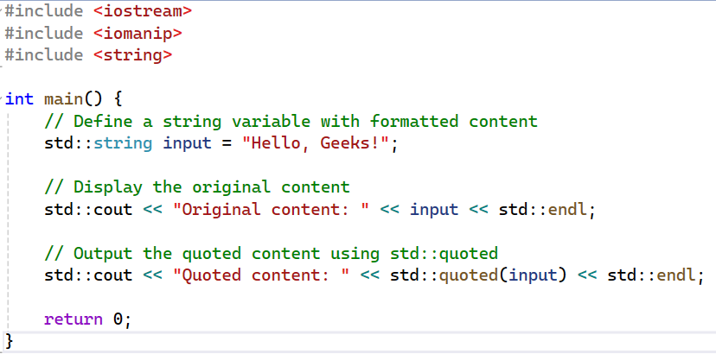
std::quoted
std::quoted provides handle quoted strings by preserving original format of string
It allows you to safely handle strings that contain spaces and special characters while keeping their formatting intact.
This function is defined in the <iomanip> header
Original content: Hello, Geeks!
Quoted content: "Hello, Geeks!"

Slide 16
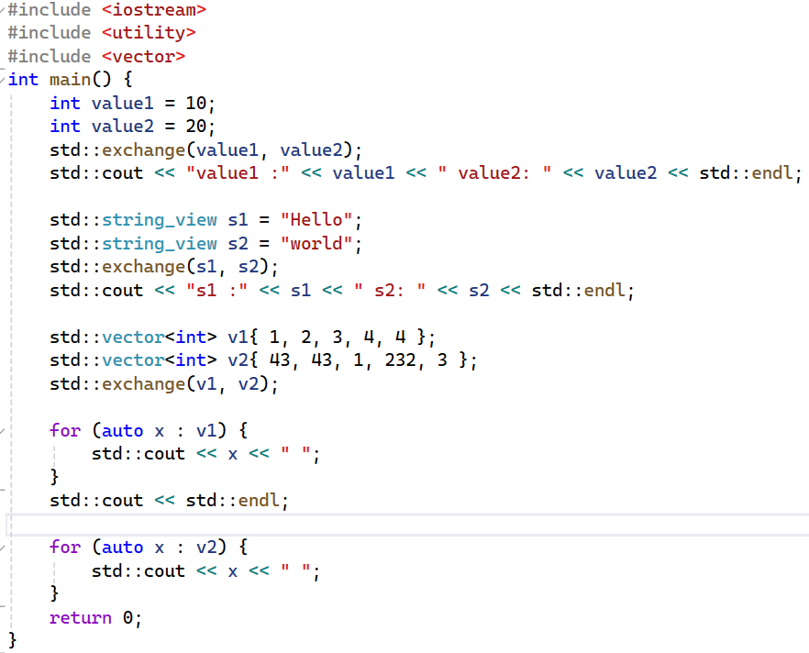
std::exchange
The exchange() function is a built-in function in C++ 14 defined in the <utility> header
The exchange() function copies new value to old value and it will return the old value
Syntax: exchange(old, new)
value1 :20 value2: 20
s1 :world s2: world
43 43 1 232 3
43 43 1 232 3

